Slide 1
Going shopping

Slide 2
People go shopping every day. We go to the butcher’s to buy meat. For tea, sugar, flour, sweets, juice or chocolate we go to the grocer’s. We buy butter, milk, eggs and cheese at the dairy. For bread, biscuits, cakes or pies we go to the baker’s. We buy fruit, vegetables and nuts at the greengrocer’s. And of course we can buy all these things in the supermarkets and at the market.
Answer the question: What shops do people go to?

Slide 3
Давайте повторим употребление Past Indefinite и Past Continuous
Yesterday my Mum, Dad and I _____ (to go) to Covent Garden. While my parents _______ (to shop), I _______ (to watch) the Street actor’s performance. The pantomime actors and the jugglers_____ (to entertain) the people around for two hours. We _______ (to leave) the performance while the people around _______ (to sing) together with the street actors.

Slide 4
Yesterday my Mum, Dad and I went to Covent Garden. While my parents were shopping, I was watching the Street actor’s performance. The pantomime actors and the jugglers were entertaining the people around for two hours. We left the performance while the people around were singing together with the street actors.

Slide 5
Have a look at the photos and name the shops.
Imagine you go to some of the shops. What do you buy there?
I go to the ….. and buy ….. there.
I go to the ….. and buy ….. there.
I go to the ….. and buy ….. there.

Slide 6
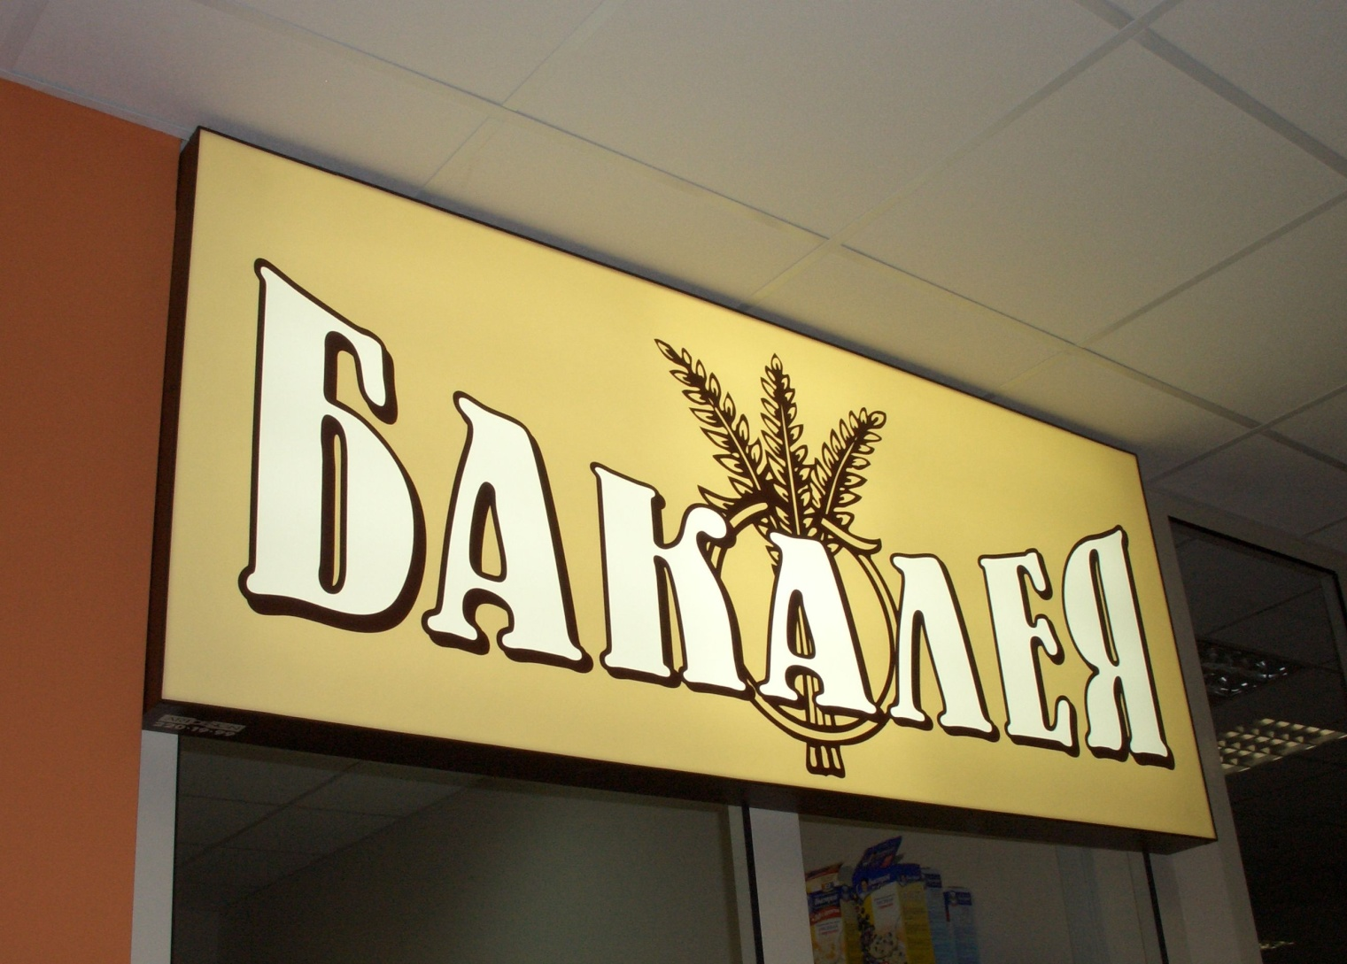
I go to the ………….…………………. and buy …………………….…..…….. there.

Slide 7
I go to the grocer’s and buy tea, sugar, flour, sweets, juice or chocolate.

Slide 8
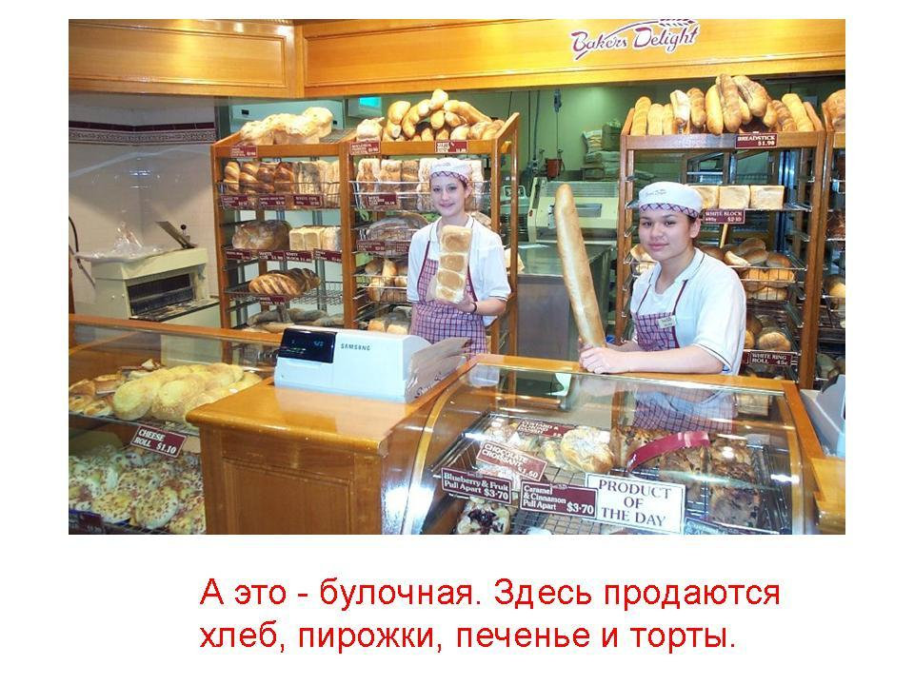
I go to the ………….…………………. and buy …………………….…..…….. there.

Slide 9
We go to the baker’s and buy bread, biscuits, cakes or pies there.

Slide 10
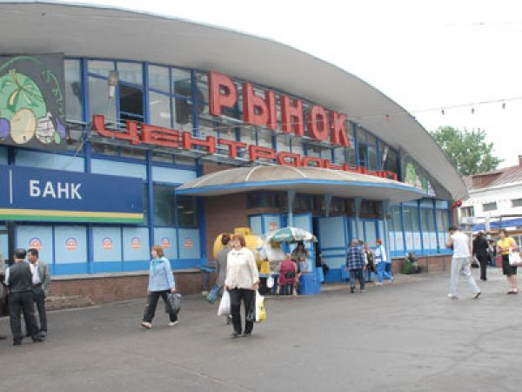
I go to the ………….…………………. and buy …………………….…..…….. there.

Slide 11
I go to the market and buy vegetables and fruit there.

Slide 12
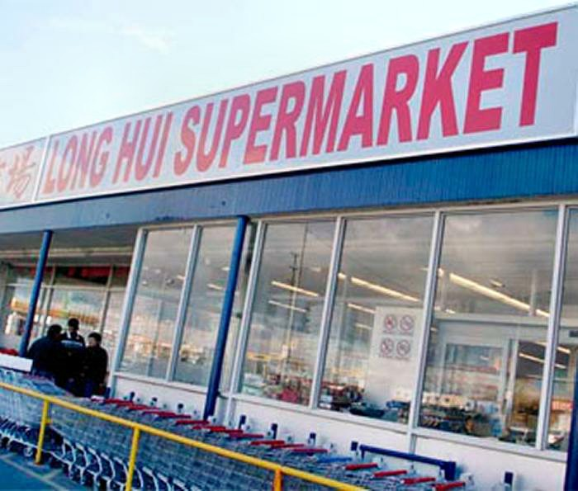
We can buy ……………………. in the …………………………...

Slide 13
We can buy everything in the supermarket.

Slide 14
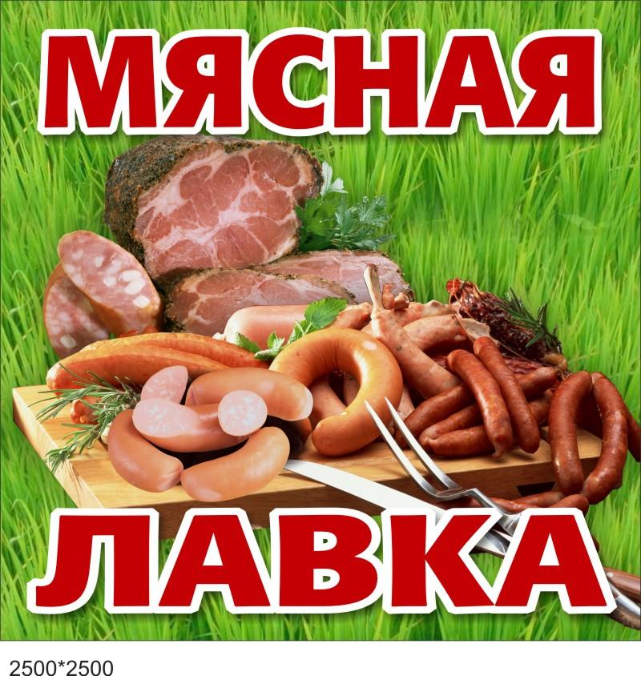
I go to the ………….…………………. and buy …………………….…..…….. there.

Slide 15
We go to the butcher’s and buy meat and sausages there.

Slide 16
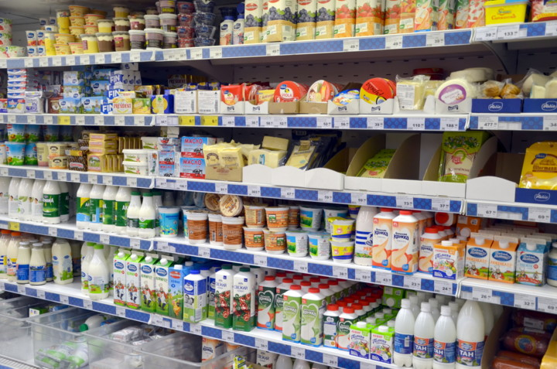
We buy ………………………..at the ………..

Slide 17
We buy butter, milk, eggs and cheese at the dairy.

Slide 18
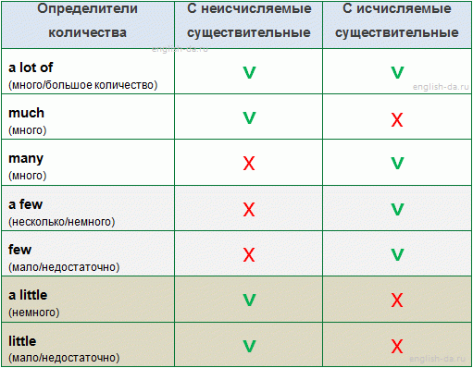

Slide 19
http://english-da.ru/grammatika/quantitative-pronouns
http://testuz.ru/eng_test.php?id=940 тесты по английскому языку

Slide 20
Good morning. ______________________
I’d like to buy a blouse.
What about these one?
Oh! It’s nice. __________________
Yes, you may.
_______________________
Five hundred rubles.
All right. I’ll take it.___________________ Thank you.
Thank you. Good-bye.
Good-bye.

